Slide 1

openSUSE Virtual Summit
Intro to Platform
May 1 & 2, 2020
The following slides will give you a better idea for the platform.
Douglas DeMaio, Manager
ddemaio@opensuse.org

Slide 2
openSUSE Virtual Summit
The openSUSE Virtual Summit is schedule to take place on May 1 and May 2 from 08:00 UTC until 15:00 UTC.
There is currently enough content to do one day and if more talks are added before April 23, we will incorporate a second day. If we have only enough content for one day, we are planning to do it on May 1.
We will be using a development platform (opensuse.reqmagic.com). You will be able to register on the website on April 30.

Slide 3
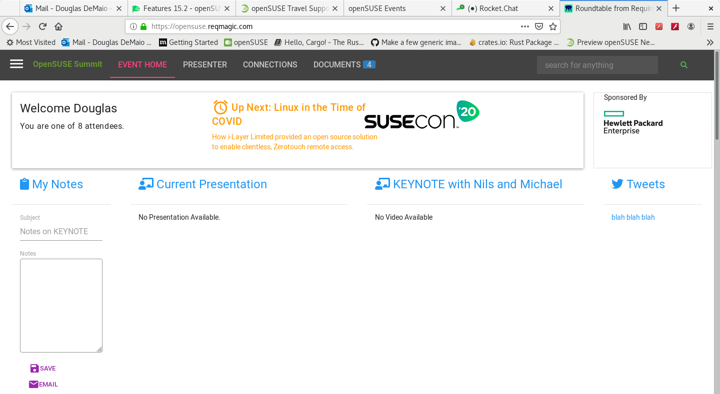
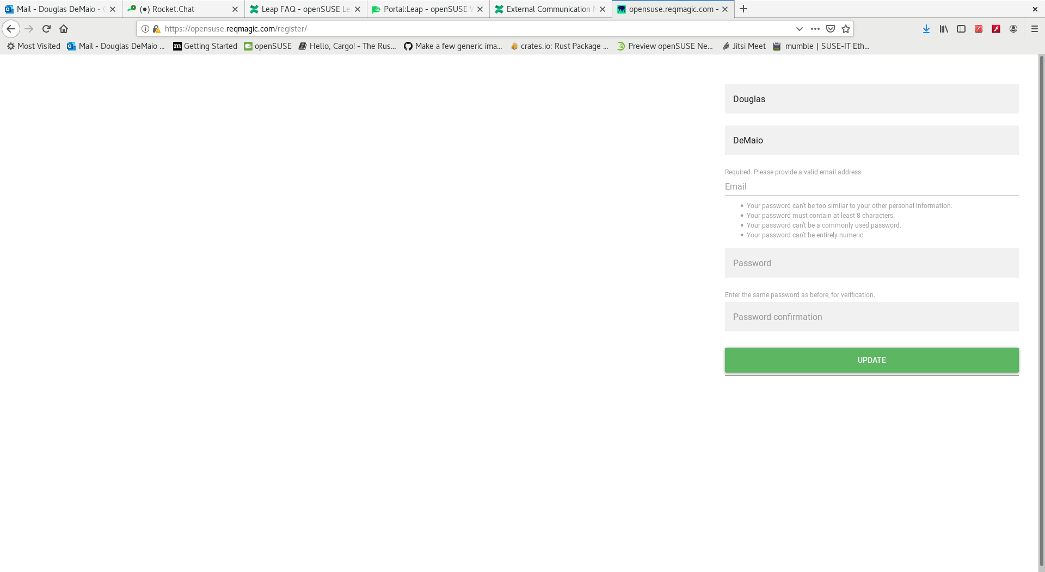
opensuse.reqmagic.com
Registration and Log in
Please registers for the summit at opensuse.reqmagic.com.
An email will be sent to you to confirm your registration.
Confirm the registration and then log in.

Slide 4
Event Home
Event Home Page View
The home page will provide a list of presentations once the schedule has been imported. This were you will be able toJOIN the talk that you want to watch.
Once in a room, others will be able to also see you in the talk as if you were in an actual room
There are four headers, Event Home, Presenter, Connections and Documents.
There is also a tab in the upper left.

Slide 5
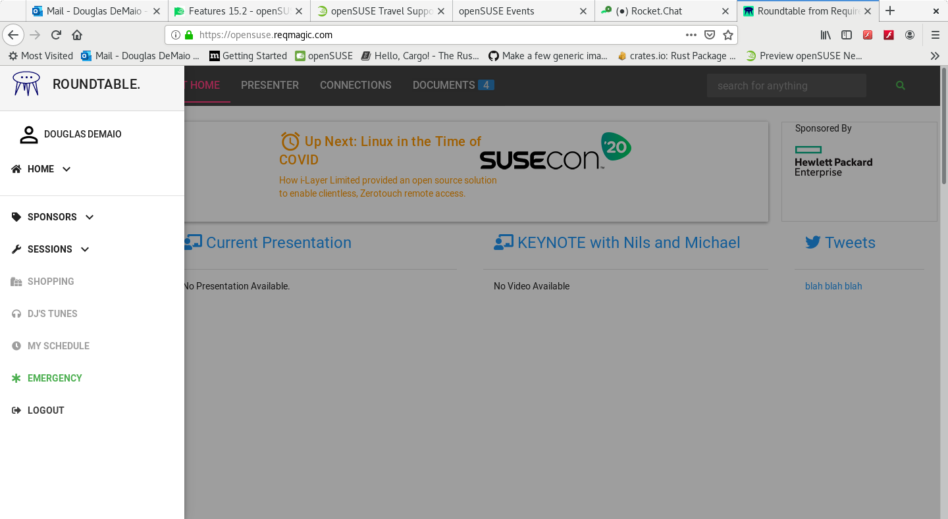
Left Tab
Left Column
The left tab is for both organizers and users. A list for sponsors is available.
Please keep in mind this is in a development platform state. We using it as a proof of concept.
Navigation to sessions is also available in the left tab as well as a spot for emergency contact information.

Slide 6
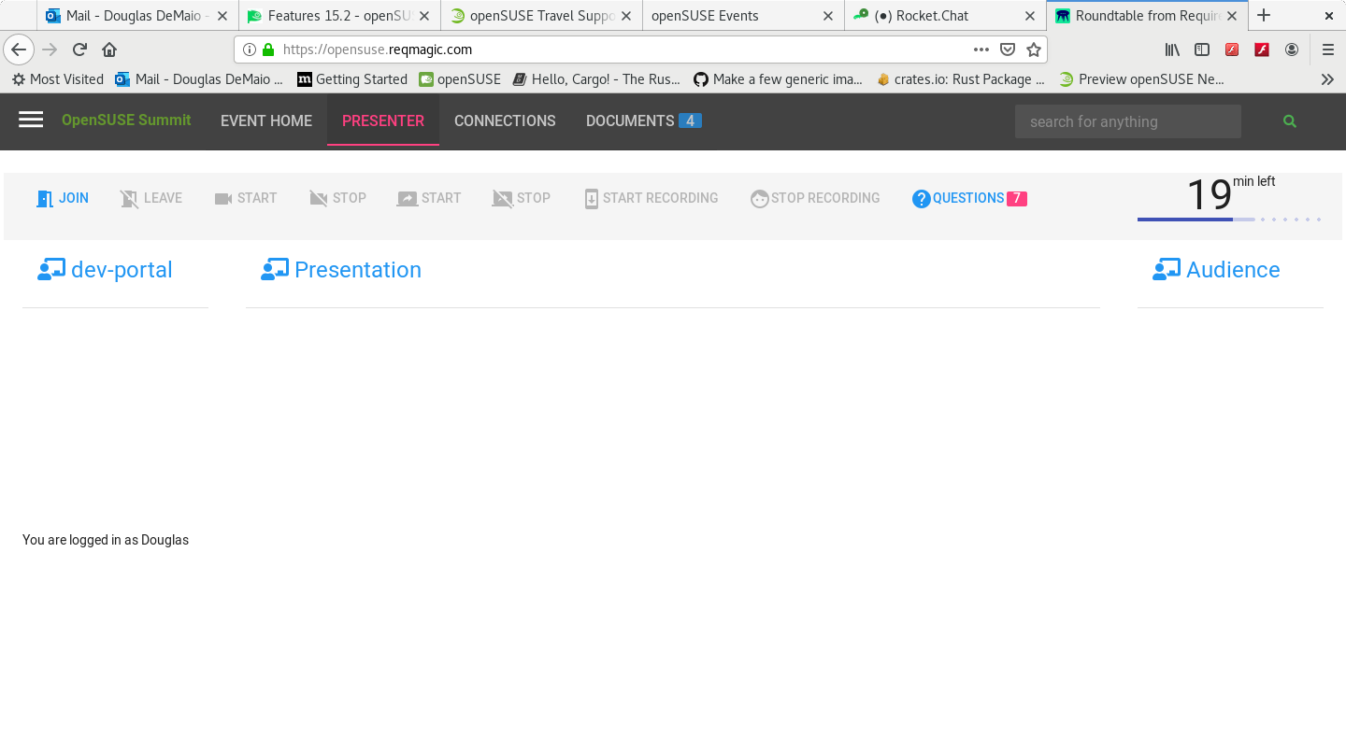
Presenter
Navigation for Presenter
Your talk will be programmed into the system, so about 10 minutes before your talk, you will be able to see an option for presenting.
The system will recognize your email account and will now you as the presenter. Please use the email account that you used for events.opensuse.org. (Thomas, I’ll put your email in place of Dex)
You will be able to share your Browser. Make sure to upload your slides to either slideshare or some tool that allows for you to view the slides in the browser.

Slide 7
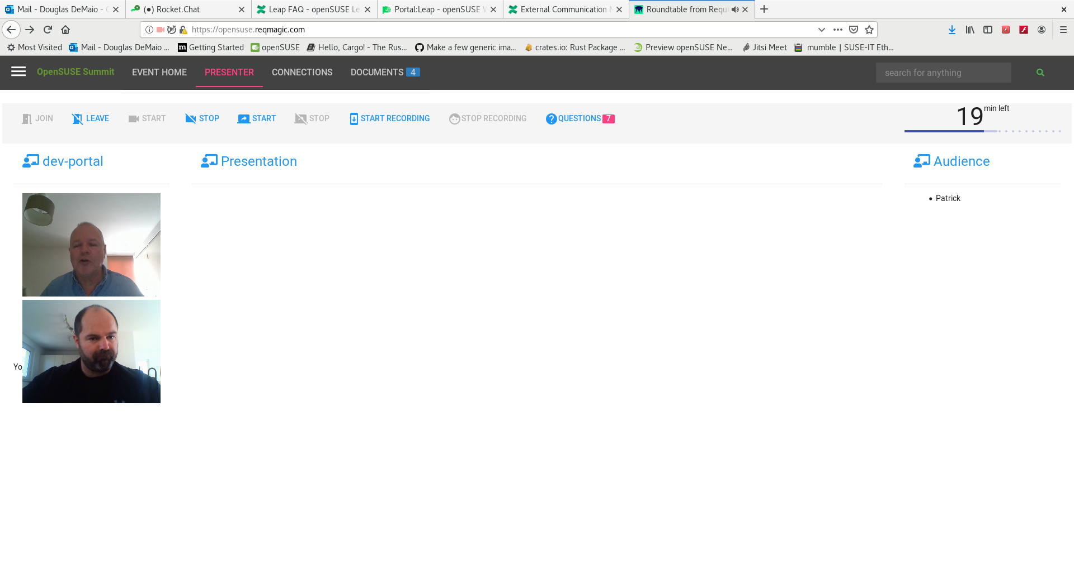
Starting The Presentation
In the Presenter Tab
Click START and then START RECORDING to begin
Once you start recording, share your browser.
Please do not click on the Events Home, Connections or Documents during your presentation; it will end your presenter session
During your talk, you will notice a counter in the upper right corner. This will let you know how long you have left to present.

Slide 8
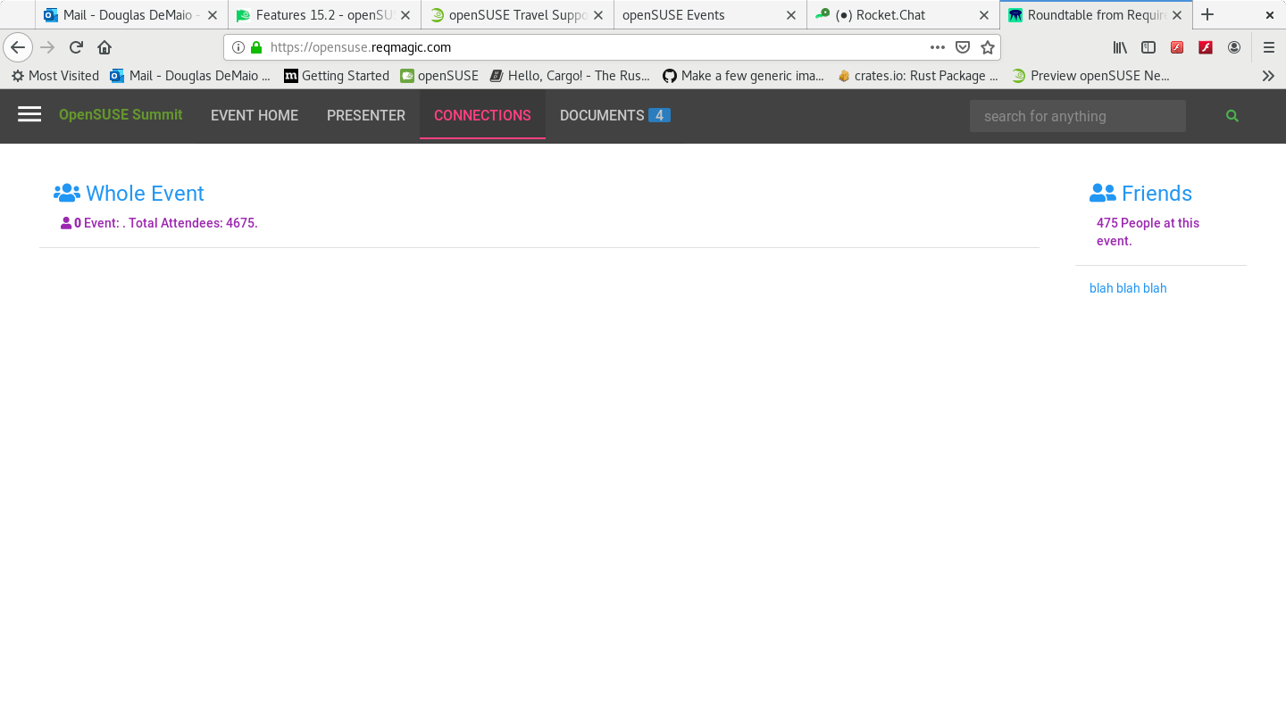
Connections
Making Connections
In the connections tab, you can make connections with people.
This is trying to replicate how you might meet and talk to people at a physical conference.
You will be able to start the information you want.
Again, this is experimental and the features for the tool are evolving, so feedback is great for the developers.

Slide 9
Finish
Thank You

